Slide 1
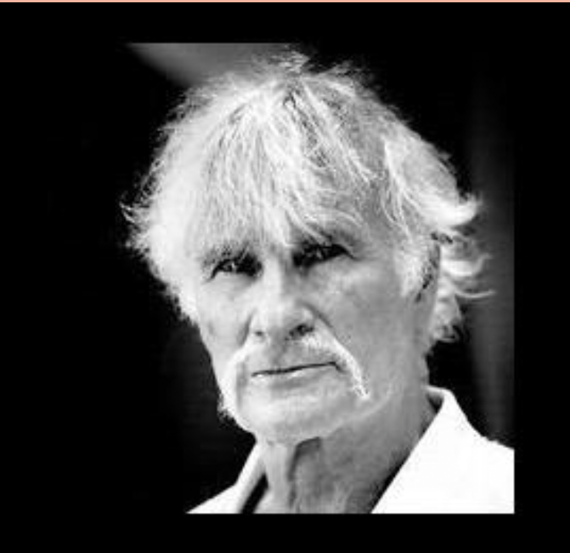
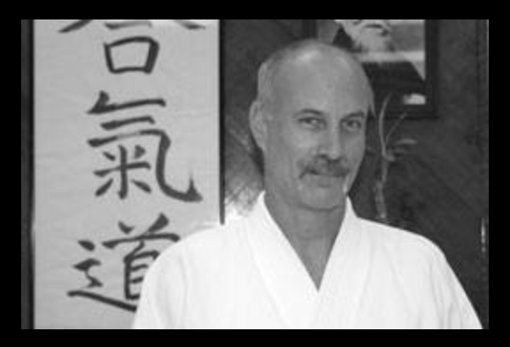
AIKIDO DOJOS OF THE HUDSON VALLEY INVITE YOU TO PLEASE JOIN US FOR A FUNDRAISING SEMINAR FOR NY AIKIKAI
1-27-24
WOODSTOCK AIKIDO
487 Upper Byrdcliffe Rd, Woodstock, NY 12498
CLASSES:
11:00-12:00
12:15-1:15
SUGGESTED DONATION $25
WITH
HARVEY KONIGSBERG SHIHAN
&
BRIAN MIZERAK SHIHAN
POTLUCK LUNCH WILL FOLLOW CLASS

